Slide 1


Cryptography was the art of secret coding
Cryptography and Information Theory
Lecture 4 : Advanced Encryption Standard
By
Nur Azman Abu
3rd Floor, Academic Building
FTMK, UTeM
Phone : +606-331-6673
Mobile : 0177722007
Email : nura@utem.edu.my
Monday 18 September 2017

Slide 2


Content
  the AES selection process
  the details of Rijndael – the AES cipher
  looked at the steps in each round
  the key expansion
  implementation aspects
    AES started in 2000, now we are going to move on to AES, the proposed successor to DES for encryption of non-classified government materials.
    Very fast in hardware, slow in software
    AES is designed to last until 2020,
    right now AES is under review in 2021.
Asymmetric
Symmetric
OTK
13 August 2007
Notes:
Estimate computer power today: 80 bits

Slide 3

13 August 2007

Slide 4

Session Key
  Also called shared secrets or Session Key k
    Alice and Bob share a single key
    Security lies in keeping the key secret
      And the strength of the specific algorithm
    Recall that, for some plaintext message M, let’s denote the encryption of that message into cipher text as
E_{k}(M) = C
And decryption
D_{k}(C) = M
    And for symmetric key algorithms, we have
D_{k}(E_{k}(M)) = M
13 August 2007

Slide 5







Key Element in Modern CryptoSystem
Ain’s Private Key
Baba’s Private Key
Decryption & Authentication
Ain’s Public Key
Baba’s Public Key
Encryption
Public Key Infrastructure
Symmetric Encryption
13 August 2007

Slide 6

List of Block Ciphers in 2000
  Blowfish
  Twofish
  Rijndael
  Tiger of Russian
  GOST (Soviet Union)
  SEED of Korean
  CAMELLIA of Japan
  RC6 of RSA
  SAFER
  LOKI from Australia
  There are many others as well…
13 August 2007

Slide 7
Where is AES?
Session Key randomly generated
Encrypted Session Key
RSA
ECC
Plaintext
Ciphertext
DES
AES
Figure 1 : Common Strategy of Encryption Mode combining Public Key Infrastructure and Standard Symmetric Encryption
13 August 2007
Notes:
Define concept of “divisors”. We say that a nonzero b divides a if a=m.b for some m, where a, b, and m are integers. That is, b divides a if there is no remainder on division. Can denote this as b|a, and say that b is a divisor of a. For example, the positive divisors of 24 are 1,2,3,4,6,8,12, and 24.

Slide 8
Modern Block Ciphers : Historical Origin
It is clear a replacement for DES was needed
It is possible to have theoretical attacks that can break it
EFF-Electronic Front Foundation has demonstrated exhaustive key search attacks
We can still use Triple-DES – but slow, it has 3 small DES blocks
US NIST issued call for ciphers in 1997
15 candidates accepted in Jun 98
5 were short-listed in Aug-99
Rijndael(“Rain Doll”) was selected as the AES in Oct-2000
issued as FIPS PUB 197 standard in Nov-2001
13 August 2007
Notes:
Note some more important properties of modular arithmetic, as discussed further in the text.

Slide 9
Strength of DES – Key Size
56-bit keys have 2⁵⁶ = 7.2 x 10¹⁶ values
brute force search for all possible keys
recent advances have shown is possible
  in 1997 on Internet in a few months
  in 1998 on dedicated h/w (EFF) in a few days
  in 1999 above combined in 22hrs!
  In 2000 dedicated USD 250K machine in less than 2 hours
still must be able to recognize plaintext
13 August 2007

Slide 10



Triple DES in Action
AES is a new cipher alternative
prior to this alternative was to use multiple encryption with DES implementations
Triple-DES is the chosen form
We can still use Triple-DES – but slow, it has 3 small DES blocks
Mainly due to cheap DES chip over the counter.
Nickname 3DES
Plaintext
Ciphertext
DES
DES
DES
56-bit Key 1
56-bit Key 2
56-bit Key 3
168-bit Key
13 August 2007
Notes:
Example showing multiplication in GF(7), from Stallings Table 4.3b.

Slide 11
Triple DES in Action
hence must use 3 encryptions?
would seem to need 3 distinct keys
but can use 2 keys with E-D-E sequence
  C = E_{K1}(D_{K2}(E_{K1}(P)))
Note: To encrypt & decrypt is equivalent in security
standardized in ANSI X9.17 & ISO8732
no current known practical attacks
E
D
E
Plaintext
Ciphertext
DES
DES
DES
56-bit Key 1
56-bit Key 2
56-bit Key 1
112-bit Key
13 August 2007
Notes:
Example showing multiplication in GF(7), from Stallings Table 4.3b.

Slide 12
Triple DES in Action
although are no practical attacks on two-key Triple-DES have some indications
can use Triple-DES with Three-Keys to avoid even these
  C = E_{K3}(D_{K2}(E_{K1}(P)))
has been adopted by some Internet applications, eg PGP, S/MIME
Plaintext
E
D
E
Ciphertext
DES
DES
DES
56-bit Key 1
56-bit Key 2
56-bit Key 3
168-bit Key
13 August 2007
Notes:
Example showing multiplication in GF(7), from Stallings Table 4.3b.

Slide 13

AES Requirements
private key symmetric block cipher
128-bit data, 128/192/256-bit keys
stronger & faster than Triple-DES
active life of 20-30 years (+ archival use)
provide full specification & design details
both C & Java implementations
NIST have released all submissions & unclassified analyses
13 August 2007
Notes:
One of the basic techniques of number theory is the Euclidean algorithm, which is a simple procedure for determining the greatest common divisor of two positive integers. Use the notation gcd(a,b) to mean the greatest common divisor of a and b. The positive integer c is said to be the greatest common divisor of a and b if c is a divisor of a and of b; and any divisor of a and b is a divisor of c.
State that two integers a and b are relatively prime if their only common positive integer factor is 1, ie GCD(a,b)=1.

Slide 14

Size does matters…
  Key sizes
    128, 192, or 256 bit keys
    There are on the order of 10²¹ more keys than in 56-bit DES
    If you could crack a DES key in one second, it would take 149 trillion years to crack a AES key by brute force at the same computing speed
    But, things change….
13 August 2007

Slide 15
Confusion and Diffusion
cipher needs to completely obscure statistical properties of original message
a one-time pad or one time key does this
more practically Shannon suggested combining S & P elements to obtain:
diffusion – dissipates statistical structure of plaintext over bulk of ciphertext
confusion – makes relationship between ciphertext and key as complex as possible
13 August 2007
Notes:
Illustrate how we can compute successive instances of GCD(a,b) = GCD(b,a mod b), example taken from text.
Note this MUST always terminate since will eventually get a mod b = 0 (ie no remainder left).
Answer is then the last non-zero value. In this case GCD(1970,1066)=2.

Slide 16
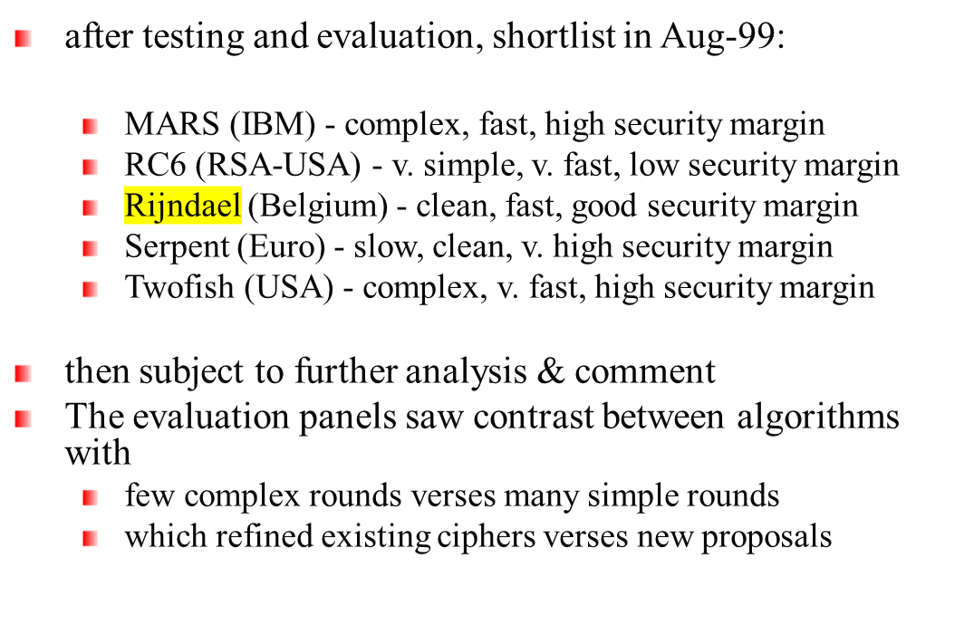
AES Shortlist
Note: mix of commercial (MARS, RC6, Twofish) verses academic (Rijndael, Serpent) All were thought to be good – it came down to the best balance of attributes to meet criteria, in particular the balance between speed, security & flexibility. Rijndael is more mathematical and elegant.
13 August 2007

Slide 17


State Array
16 byte elements in a columnwise matrix
Message Plaintext
Message Plaintext
Ciphertext
0
0
4
8
12
4
8
12
AES
1
5
9
13
1
5
9
13
2
6
10
14
2
6
10
14
3
7
11
15
3
7
11
15
4 X 4
4 X 4
4 X 4
Decrypt
Encrypt
Key – 128Bits
13 August 2007

Slide 18
AES Key Size, Block and Rounds
Key Length
(Nk words)
Block Size
(Nb words)
No. of Rounds
(Nr)
AES-128
4
4
10
AES-192
6
4
12
AES-256
8
4
14
AES^{ATM}–320
10
10
16
13 August 2007

Slide 19
      Rijndael(State,Key)
      K = KeyExpansion(Key)
      AddRoundKey(State, K)
      for( i = 0; i<Nround ; i++)
        Round(State, K)
        FinalRound(State, K)
  The Round structure written in pseudo C
    Round(State, RoundKey)
      ByteSub(State)
      ShiftRow(State)
      MixColumn(State)
      AddRoundKey(State, RoundKey)
13 August 2007
Notes:
ByteSub(State)
ShiftRow(State)
MixColumn(State) – compute lookup table for multiplication
AddRoundKey(State, RoundKey) -

Slide 20

cryptography is a mathematical science
Rijndael
The key is expanded into 44/52/60 lots of 32-bit words (see later), with 4 used in each round.
The data computation then consists of an “add round key” step, then 9/11/13 rounds with all 4 steps,
but a final 10th/12th/14th round with 3 steps of byte subs + mix cols + add round key.
13 August 2007

Slide 21

Step 1 : Byte Substitution : a simple substitution of each byte
The Substitute bytes stage uses an S-box to perform a byte-by-byte substitution of the block.
uses one table of 16x16 bytes containing a permutation of all 256 8-bit values
each byte of state is replaced by byte indexed by row (left 4-bits) & column (right 4-bits)
  eg. byte {95} is replaced by byte in row 9 column 5 which has value {2A}
S-box constructed using defined transformation of values in GF(2⁸)
designed to be resistant to all known attacks
S-Box was designed to be resistant to known cryptanalytic attacks. Specifically, the Rijndael developers sought a design that has a low correlation between input bits and output bits
13 August 2007
Notes:
Define concept of “divisors”. We say that a nonzero b divides a if a=m.b for some m, where a, b, and m are integers. That is, b divides a if there is no remainder on division. Can denote this as b|a, and say that b is a divisor of a. For example, the positive divisors of 24 are 1,2,3,4,6,8,12, and 24.

Slide 22
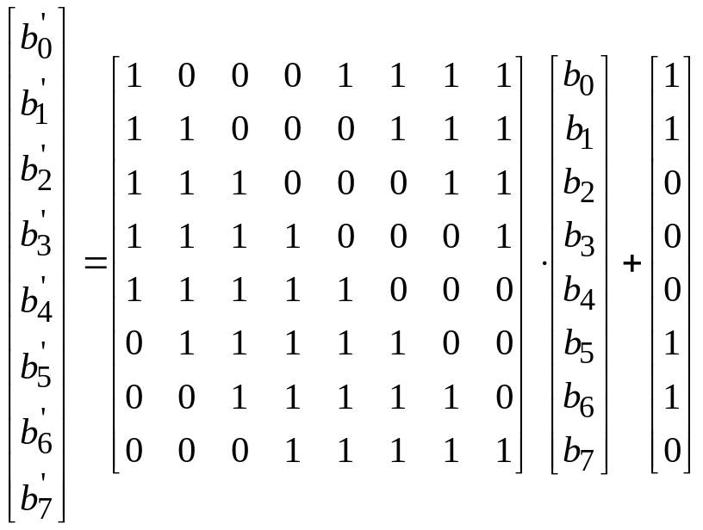
Step 1 : S-box
First, the byte will be inversed mod irreducible polynomial.
Second, it will go thru affine transform
S-box
0
4
8
12
0
4
8
12
1
5
9
13
1
5
9
13
2
6
10
14
2
6
10
14
3
7
11
15
3
7
11
15
Non-linear byte
New byte values
13 August 2007

Slide 23
S |  | y
 |  | 0 | 1 | 2 | 3 | 4 | 5 | 6 | 7 | 8 | 9 | a | b | c | d | e | f
x | 0 | 63 | 7c | 77 | 7b | f2 | 6b | 6f | c5 | 30 | 01 | 67 | 2b | fe | d7 | ab | 76
 | 1 | ca | 82 | c9 | 7d | fa | 59 | 47 | f0 | ad | d4 | a2 | af | 9c | a4 | 72 | c0
 | 2 | b7 | fd | 93 | 26 | 36 | 3f | f7 | cc | 34 | a5 | e5 | f1 | 71 | d8 | 31 | 15
 | 3 | 04 | c7 | 23 | c3 | 18 | 96 | 05 | 9a | 07 | 12 | 80 | e2 | eb | 27 | b2 | 75
 | 4 | 09 | 83 | 2c | 1a | 1b | 6e | 5a | a0 | 52 | 3b | d6 | b3 | 29 | e3 | 2f | 84
 | 5 | 53 | d1 | 00 | ed | 20 | fc | b1 | 5b | 6a | cb | be | 39 | 4a | 4c | 58 | cf
 | 6 | d0 | ef | aa | fb | 43 | 4d | 33 | 85 | 45 | f9 | 02 | 7f | 50 | 3c | 9f | a8
 | 7 | 51 | a3 | 40 | 8f | 92 | 9d | 38 | f5 | bc | b6 | da | 21 | 10 | ff | f3 | d2
 | 8 | cd | 0c | 13 | ec | 5f | 97 | 44 | 17 | c4 | a7 | 7e | 3d | 64 | 5d | 19 | 73
 | 9 | 60 | 81 | 4f | dc | 22 | 2a | 90 | 88 | 46 | ee | b8 | 14 | de | 5e | 0b | db
 | a | e0 | 32 | 3a | 0a | 49 | 06 | 24 | 5c | c2 | d3 | ac | 62 | 91 | 95 | e4 | 79
 | b | e7 | c8 | 37 | 6d | 8d | d5 | 4e | a9 | 6c | 56 | f4 | ea | 65 | 7a | ae | 08
 | c | ba | 78 | 25 | 2e | 1c | a6 | b4 | c6 | e8 | dd | 74 | 1f | 4b | bd | 8b | 8a
 | d | 70 | 3e | b5 | 66 | 48 | 03 | f6 | 0e | 61 | 35 | 57 | b9 | 86 | c1 | 1d | 9e
 | e | e1 | f8 | 98 | 11 | 69 | d9 | 8e | 94 | 9b | 1e | 87 | e9 | ce | 55 | 28 | df
 | f | 8c | a1 | 89 | 0d | bf | e6 | 42 | 68 | 41 | 99 | 2d | 0f | b0 | 54 | bb | 16
13 August 2007

Slide 24
Step 2: Shift Rows
a circular byte shift in each
  1st row is unchanged
  2nd row does 1 byte circular shift to left
  3rd row does 2 byte circular shift to left
  4th row does 3 byte circular shift to left
decrypt inverts using shifts to right
since state is processed by columns, this step permutes bytes between the columns
The ShiftRows stage provides a simple “permutation” of the data. Further, since the state is treated as a block of columns, it is this step which provides for diffusion of values between columns. It performs a circular rotate on each row of 0, 1, 2 & 3 places for respective rows. This row shift moves an individual byte from one column to another, which is a linear distance of a multiple of 4 bytes, and ensures that the 4 bytes of one column are spread out to four different columns.
13 August 2007

Slide 25
Step 2: Shift Rows
Similar to Permutation/Transposition
Shift Counter Clockwise
ShiftRows()
Transformation
A⁰
B⁴
C⁸
D¹²
A⁰
B⁴
C⁸
D¹²
E¹
F⁵
G⁹
H¹³
F⁵
G⁹
H¹³
E¹
P²
Q⁶
R¹⁰
S¹⁴
R³⁴
S¹⁴
P²
Q⁶
U³
V⁷
W¹¹
X¹⁵
1st Shift
X¹⁵
U³
V⁷
W¹¹
Before Shift
2nd Shift
After Shift
13 August 2007

Slide 26

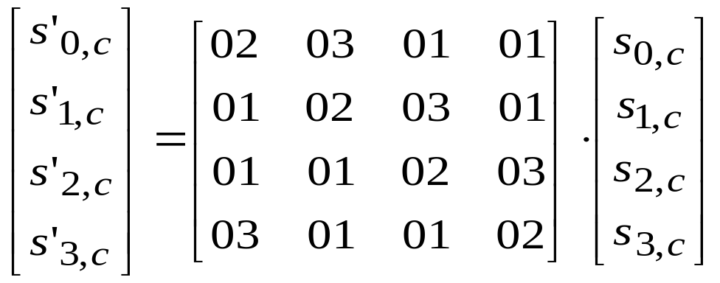
Step 3 : Mix Columns
each column is processed separately
each byte is replaced by a value dependent on all 4 bytes in the column
effectively a matrix multiplication in GF(2⁸) using prime polynomial m(x) = x⁸ + x⁴+ x³ + x + 1
The MixColumns() transformation acts independently on every column c of the state.
13 August 2007

Slide 27
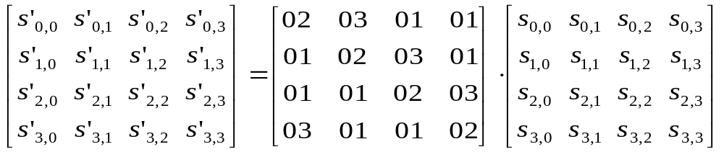
Mix-Column as P-box
Mix-Column
P-box
8
8
9
9
10
0
4
12
10
0
4
12
11
1
5
13
11
1
5
13
2
6
14
2
6
14
3
7
15
before
3
7
15
new after
13 August 2007

Slide 28
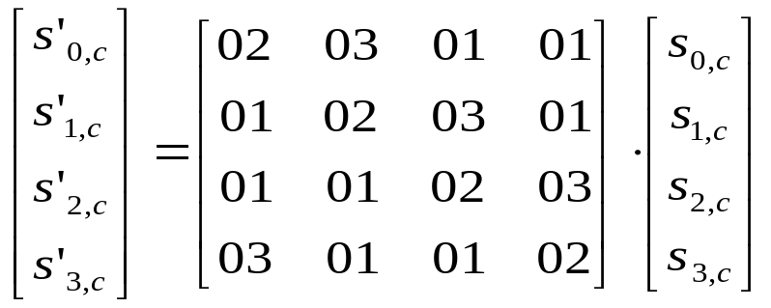
Traditionally these operations shall be done column by column.
Let s’_{0,c} = {x₀ y₀}, s’_{1,c} = {x₁ y₁}, s’_{2,c} = {x₂ y₂}, s’_{3,c} = {x₃ y₃},
s’_{0, c} = {02}•{x₀ y₀} ⊕ {03}•{x₁ y₁} ⊕ {01}•{x₂ y₂} ⊕ {01}•{x₃ y₃}
s’_{1, c} = {01}•{x₀ y₀} ⊕ {02}•{x₁ y₁} ⊕ {03}•{x₂ y₂} ⊕ {01}•{x₃ y₃}
s’_{2, c} = {01}•{x₀ y₀} ⊕ {01}•{x₁ y₁} ⊕ {02}•{x₂ y₂} ⊕ {03}•{x₃ y₃}
s’_{3, c} = {03}•{x₀ y₀} ⊕ {01}•{x₁ y₁} ⊕ {01}•{x₂ y₂} ⊕ {02}•{x₃ y₃}
Note : ⊕ is an exclusive-or binary-byte operation.
s₀₀ = AB = 10101011, then
{03}•{AB}=11⋅10101011
= 10101011
10101011
= 111111101 mod 100011011
100011011
11100110=E6.
13 August 2007

Slide 29
Step 4: Add Round Key
XOR state with 128-bits of the round key
again processed by column (though effectively a series of byte operations)
inverse for decryption identical
  since XOR own inverse, with reversed keys
designed to be as simple as possible
  a form of Vernam cipher on expanded key
  requires other stages for complexity / security
Lastly is the Add Round Key stage which is a simple bitwise XOR of the current block with a portion of the expanded key. MUST be used at start and end of each round, since otherwise could undo effect of other steps. But the other steps provide confusion/diffusion/non-linearity. This is efficient and highly secure it is believed.
13 August 2007

Slide 30
Step 4: Add Round Key
AddRound Key
8
⊕
=
8
9
9
10
0
4
12
10
0
4
12
11
1
5
13
w₂
11
1
5
13
2
6
14
2
6
14
3
7
15
3
7
15
before
w₀
w₁
w₃
new after
13 August 2007

Slide 31
Preparing Round Keys
Round Key 10
Round Key 3
Round Key 2
Round Key 1
Round Key 0
0
4
8
12
1
5
9
13
2
6
10
14
3
7
11
15
w₀
w₁
w₂
w₃
13 August 2007

Slide 32
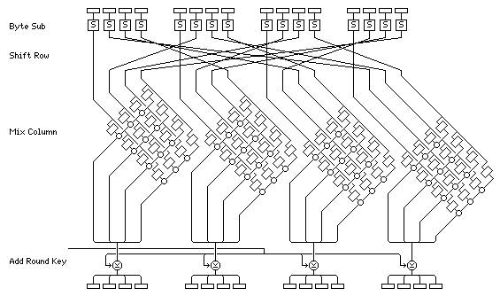
AES Rounds
13 August 2007

Slide 33
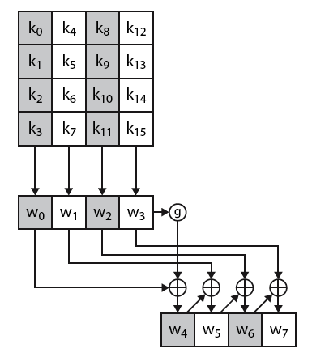
AES Key Expansion
The first block of the AES Key Expansion is shown here. It shows each group of 4 bytes in the key being assigned to the first 4 words, then the calculation of the next 4 words based on the values of the previous 4 words, which is repeated enough times to create all the necessary sub-key information.
13 August 2007

Slide 34
AES Implementation Aspects
It can be efficiently implemented on 8-bit CPU
  Step 1- byte substitution works on bytes using a table S of 256 entries
  Step 2 - shift rows is simple byte shift
  Step 3 - mix columns requires matrix multiply in GF(2⁸) which works on byte values, can be simplified to use table lookups* & byte XOR’s
  Step 4 - add round key works on byte XOR’s
* a 2nd 256 byte table X₂, using the formulae shown in Stallings equation 5.9.
13 August 2007
Notes:
Today: 64-bit processor

